Slide 1
All-Pairs Shortest Paths
Chaklam Silpasuwanchai

Slide 2
Readings
Chapter 25, All-Pairs Shortest Paths, Cormen et al. (2009). Introduction to Algorithms, Third Edition (3rd ed.). The MIT Press.
Design and Analysis of Algorithms, MIT - https://ocw.mit.edu/courses/electrical-engineering-and-computer-science/6-046j-design-and-analysis-of-algorithms-spring-2015/

Slide 3
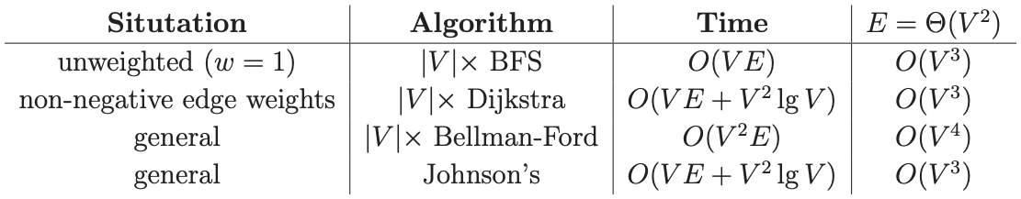
All-Pairs Shortest Paths (APSP)
Single-source shortest paths
given directed graph G = (V, E), vertex s ∈ V, edge weights w: E -> ℝ
find 𝛿 (s, v) = shortest-path weight s -> v for ∀ v ∈ V
All-Pairs Shortest Paths
given G = (V, E, w)
find 𝛿 (u, v) for ∀ u, v ∈ V
Real-world shortest paths - often pre-computed
A simple way of solving all-pairs shortest paths is by running single source shortest path algorithm for each of V vertices in the graph

Slide 4
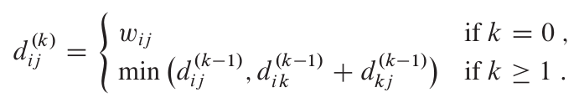
Floyd-Warshall algorithm
Floyd-Warshall algorithm - runs in Θ(V³)
Assume no negative-weight cycles
Dynamic programming
Considers the intermediate vertices of a shortest path, where an intermediate vertex of a simple path p = <v₁, v₂, …., v_{l}> is any vertex of p other than v₁ or v_{l,} that is, any vertex in the set {v₂, v₃, …., v_{l-1}}. Let d_{ij}(k) be the weight of the shortest path from vertex i to j from which all intermediate vertices are in the set {1, 2, ….k}, then d_{ij}(k) is

Slide 5
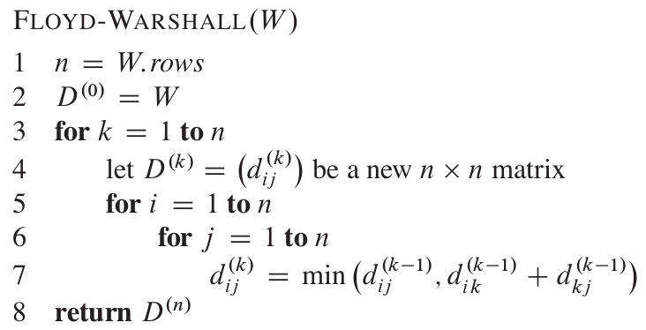
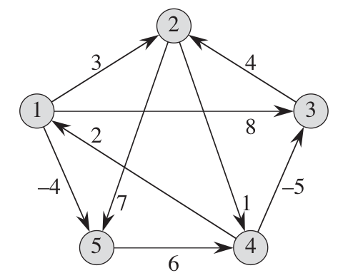
Floyd-Warshall algorithm

Slide 6
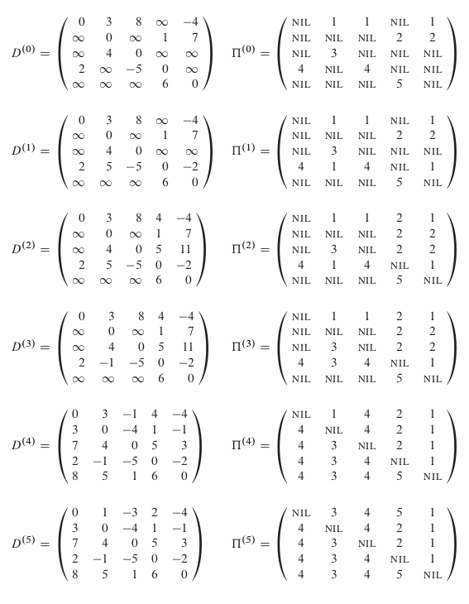
Floyd-Warshall algorithm

